Slide 1
2020 Fall Product Program Training
Girl Scouts Black Diamond

Slide 2
Thank You!
We appreciate your time, energy and efforts
Our Product Program is a success because of YOU!
You help your girls learn and develop skills that last a lifetime
We are excited to kick off this new Girl Scout year with you and look forward to “bravely sharing our strengths”

Slide 3
Three toed pygmy sloth
Found living on Isla Escudo de Veraguas off the coast of Panama
It is the smallest of the three toed sloths and was only recognized as a species in 2001
Habitat destruction is the largest threat to the species
Sloths can swim
A unique species of green algae is found on the fur and is considered symbiotic, providing camouflage without detriment to their health
Population <100
Size around 6 pounds
Eats primarily leaves of red mangroves

Slide 4
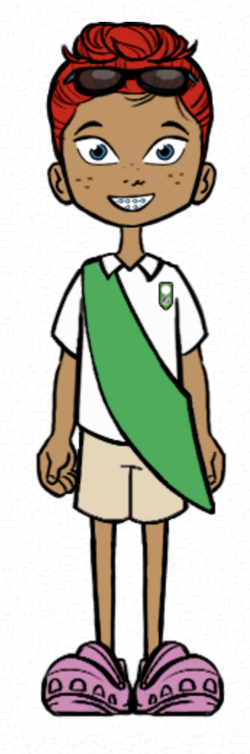
2020 Girl Rewards

Slide 5
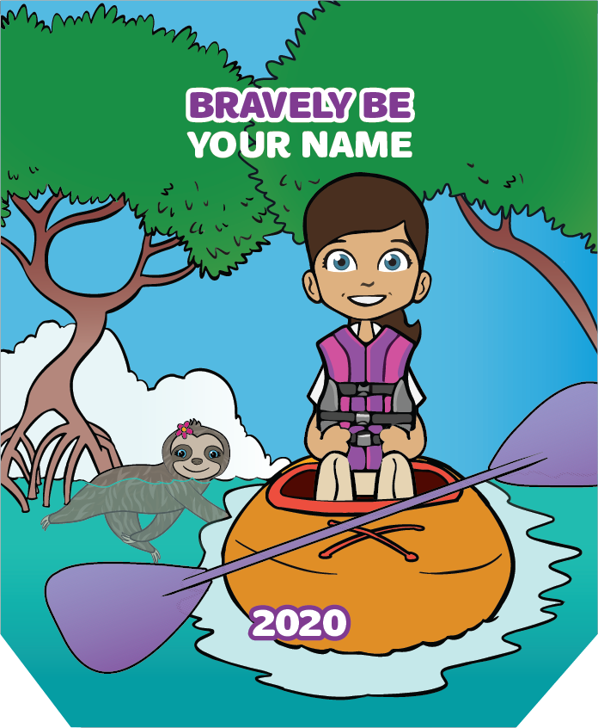
Personalized Patches
Girls choose an adventure for their avatar
Kayak with swimming sloths down a mangrove-lined river
Relax on a hammock with a sloth friend and her baby
Earned by:
Sending 15+ Emails & selling $300+ in total Fall Items
Patches are shipped directly to girls

Slide 6
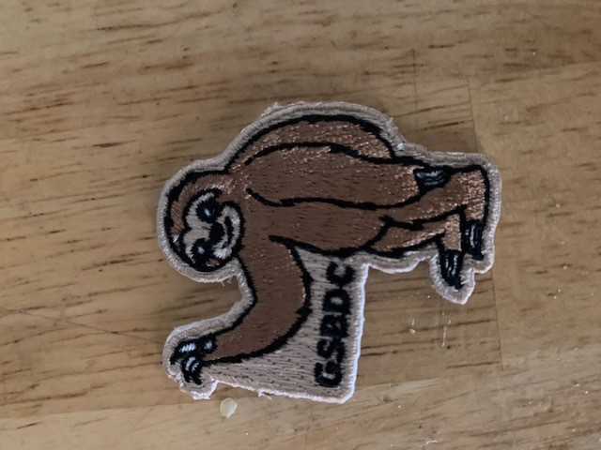
Special 2020 Patch
New for 2020
From Oct. 1 – Oct . 10 First 500 Girls to send set up their account and send 15 emails will receive this special 2020 Patch.

Slide 7
Earn 15% for each magazine & direct-ship nut item purchased!
Earn $.85 for each in-person or girl-delivered nut item!​
Troop proceeds

Slide 8
Two Ways to Participate
Girls offer a variety of items to family and friends in two ways
In-person using a nut order card
Online sending emails and sharing link on social media to purchase magazines and nuts/chocolates

Slide 9
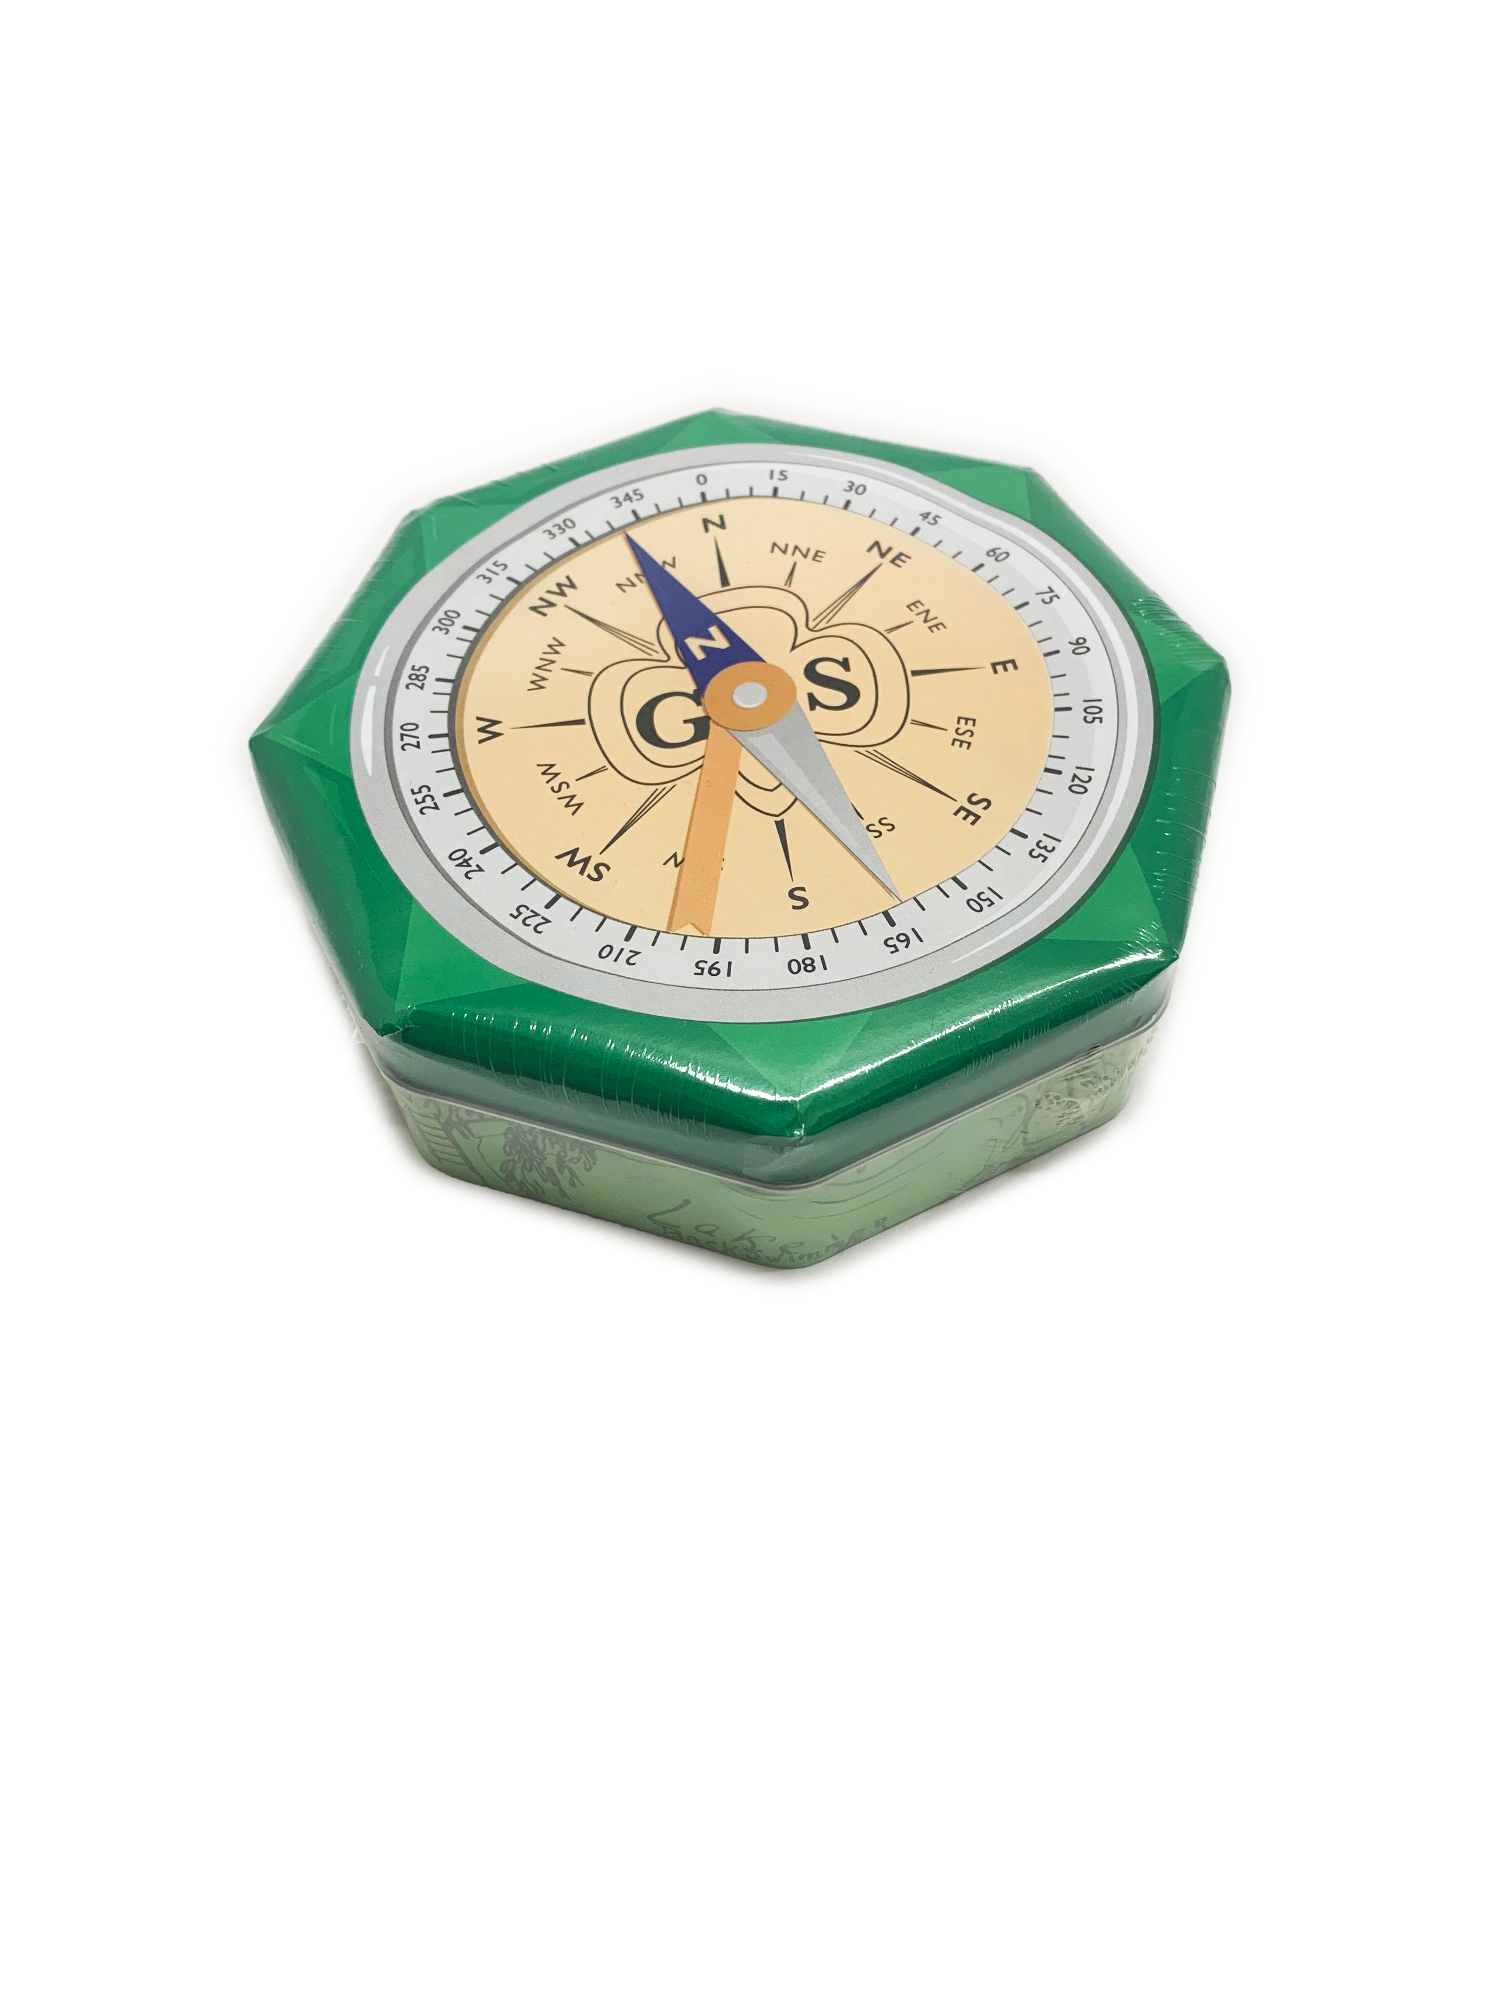
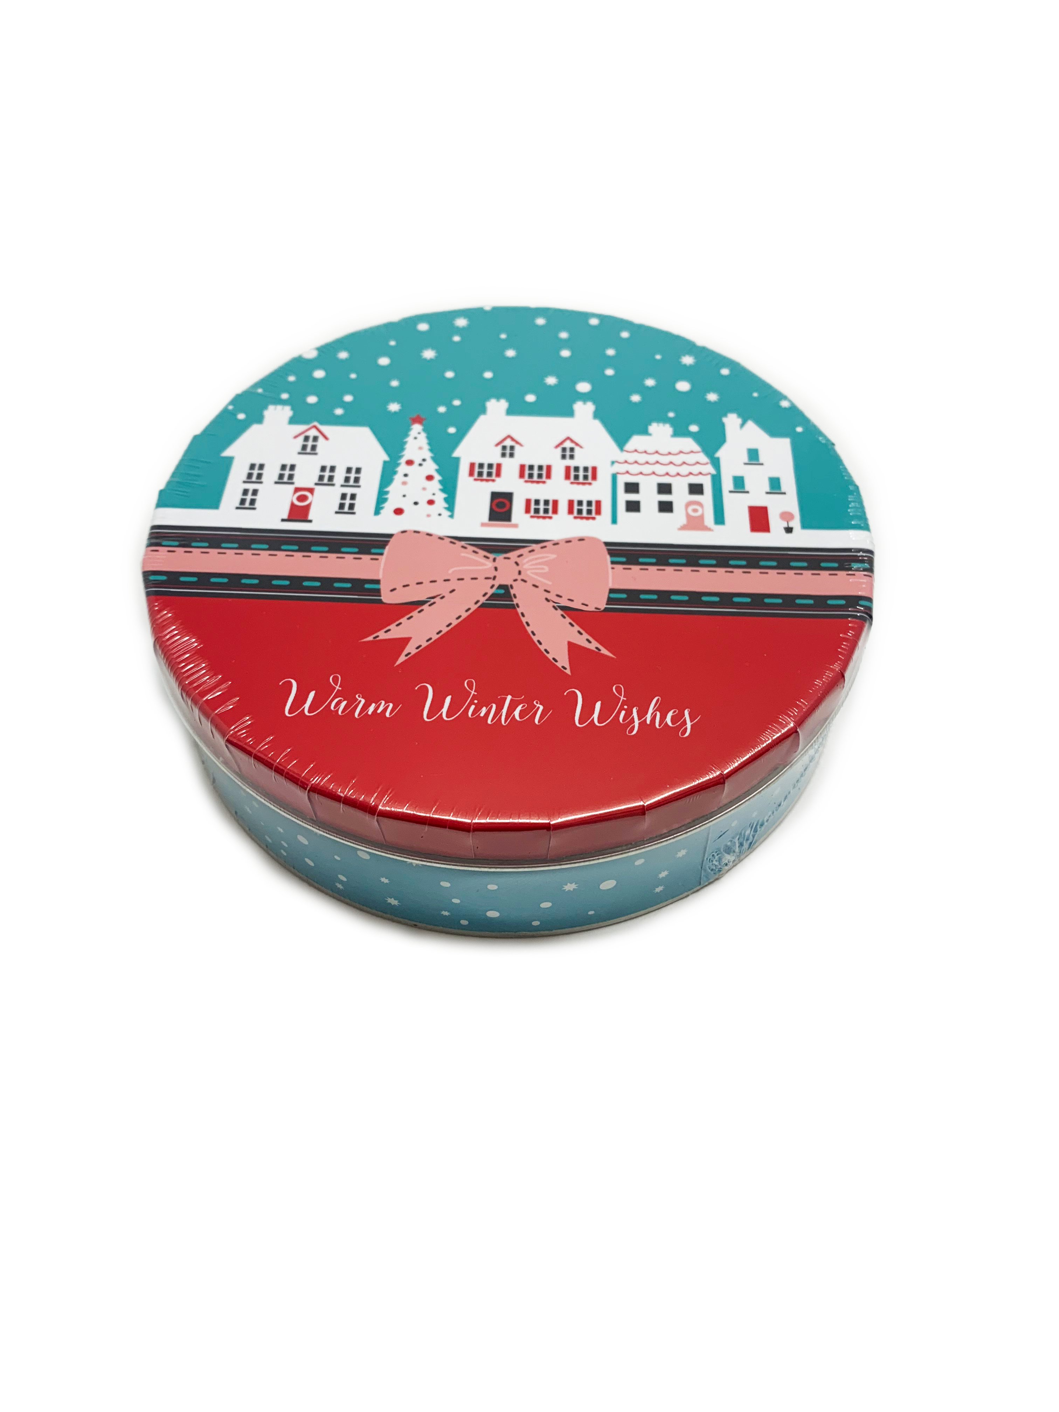
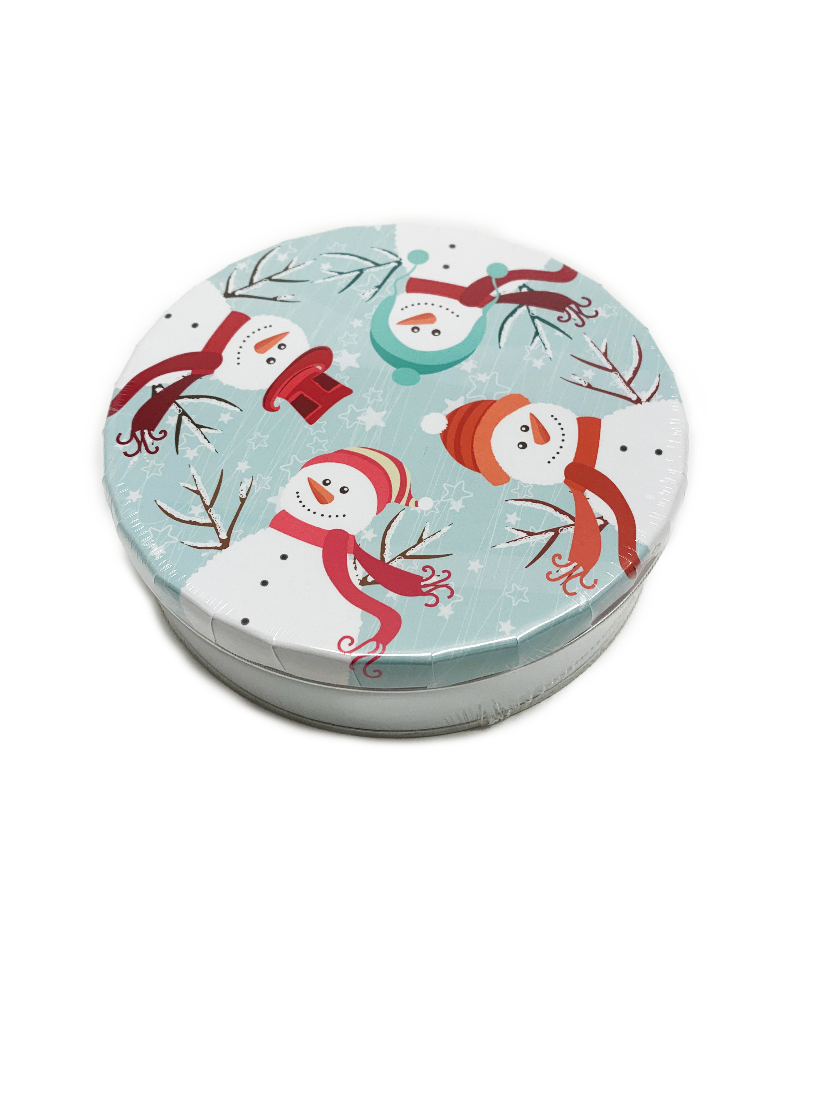
In-person Nut/Chocolate Items
Delicious selection of items
Holiday Tin & Gift Items
Care to Share

Slide 10
Girl Online Experience
Create a virtual likeness
Creating avatars makes participating fun and gets results with PATENTED Girl Scout platform
Notes:
Zip: 96910

Slide 11
Getting Started
Girls log in as a first-time participant or as a returning user from last year
Spanish experience available

Slide 12
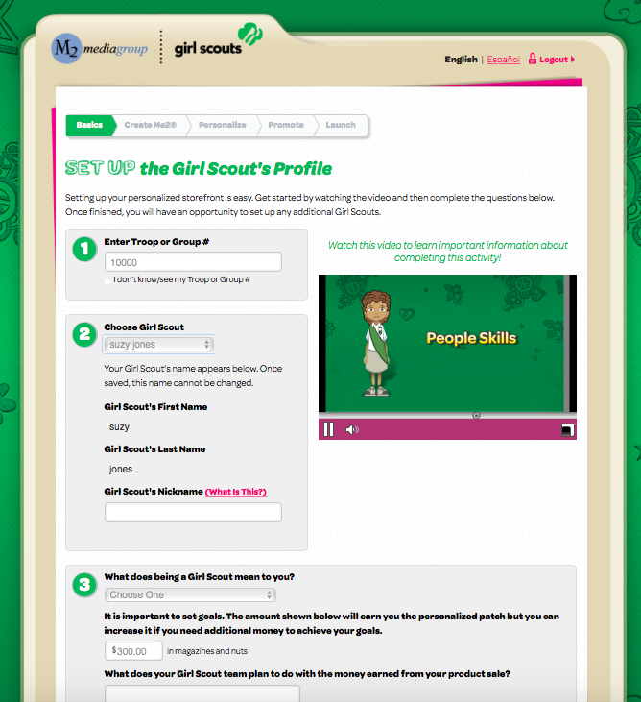
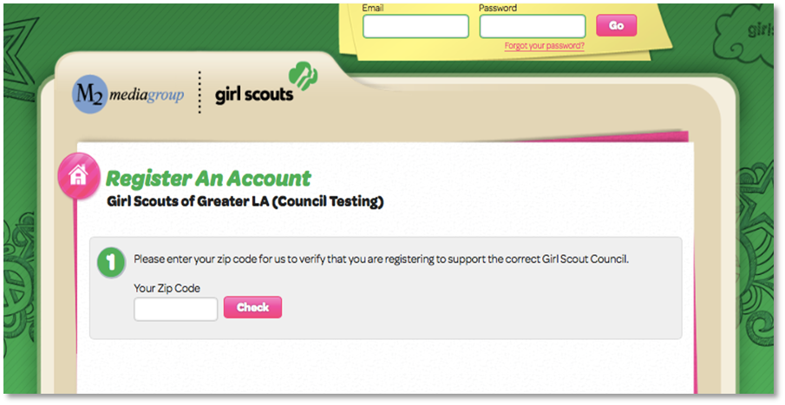
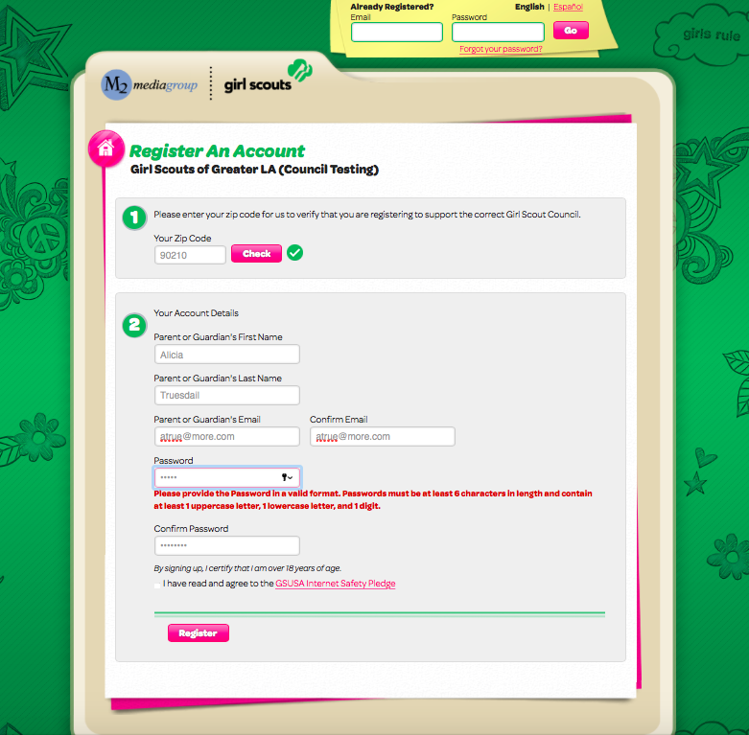
Registering an Account
Zip code validation ensuring girl in correct council
Troop number selection or “I don’t know/see my Troop#/Group#”
Participant can edit nickname
Answer questions about girl goals and what Girl Scouting means to her
Participant information and secure password setup

Slide 13
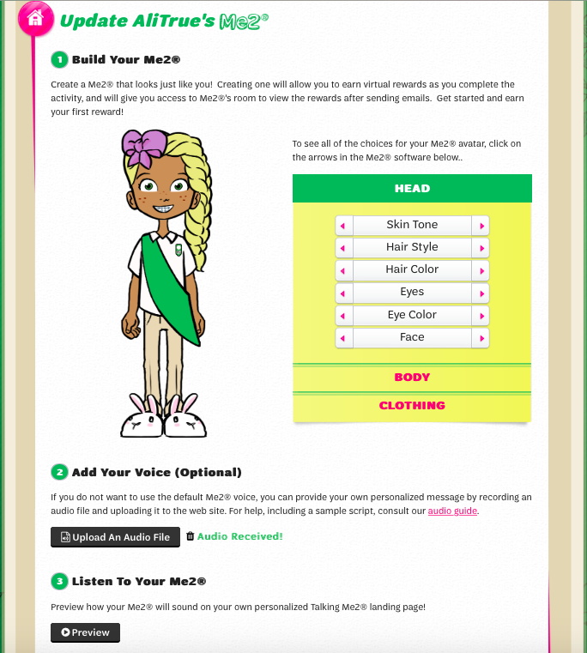
Create Avatar & Record Voice
Avatar
Girl designs her own likeness with over 3 billion avatar feature combinations
New feature choices for Fall 2020

Slide 14
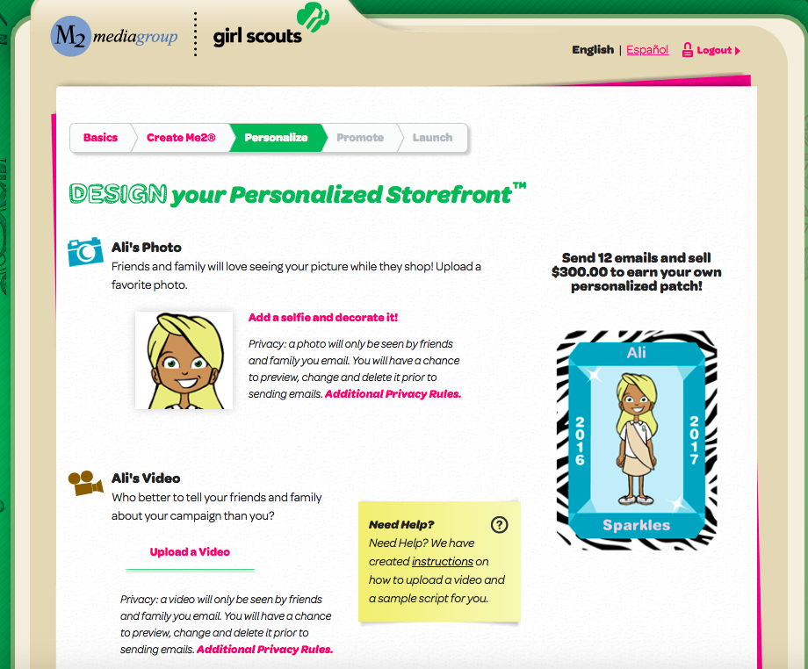
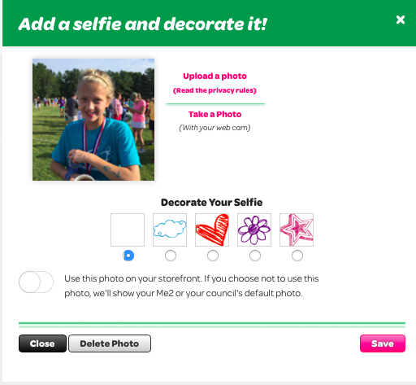
Personalized Campaign
Send 15 emails and sell
Girls can upload a photo or a video which can be shared on their online storefront
Girls who upload photos and/or videos sell more to reach their goals

Slide 15
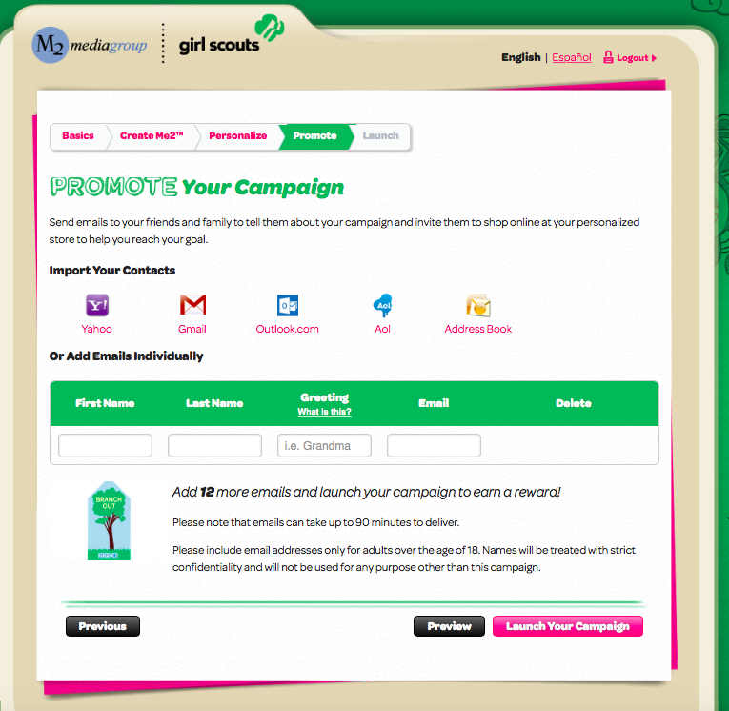
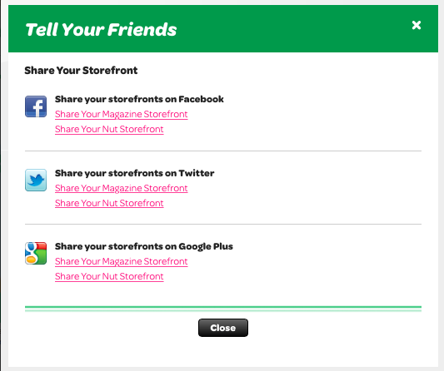
Promoting Her Campaign
Girls share their online storefront link with family and friends by sending emails or sharing on social media
27% of online sales come from social media
Girls also have business cards that they can print with their storefront code
Take a picture of the business card and text family and friends.
Easier for returning girls with customer email addresses saved year over year
Option to include last name so friends and family know who is sending the email
Simplicity of one click renewals for customers previously purchasing magazines

Slide 16
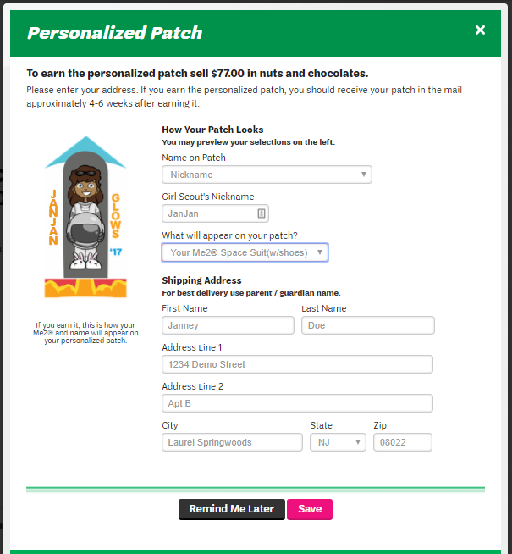
Personalized Patch Shipping
Girl chooses name, nickname or initials for her patch
Girl makes selection between two patch backgrounds
Opportunity to provide mailing address after login
Personalized patches ship directly to girls as earned throughout the program

Slide 17
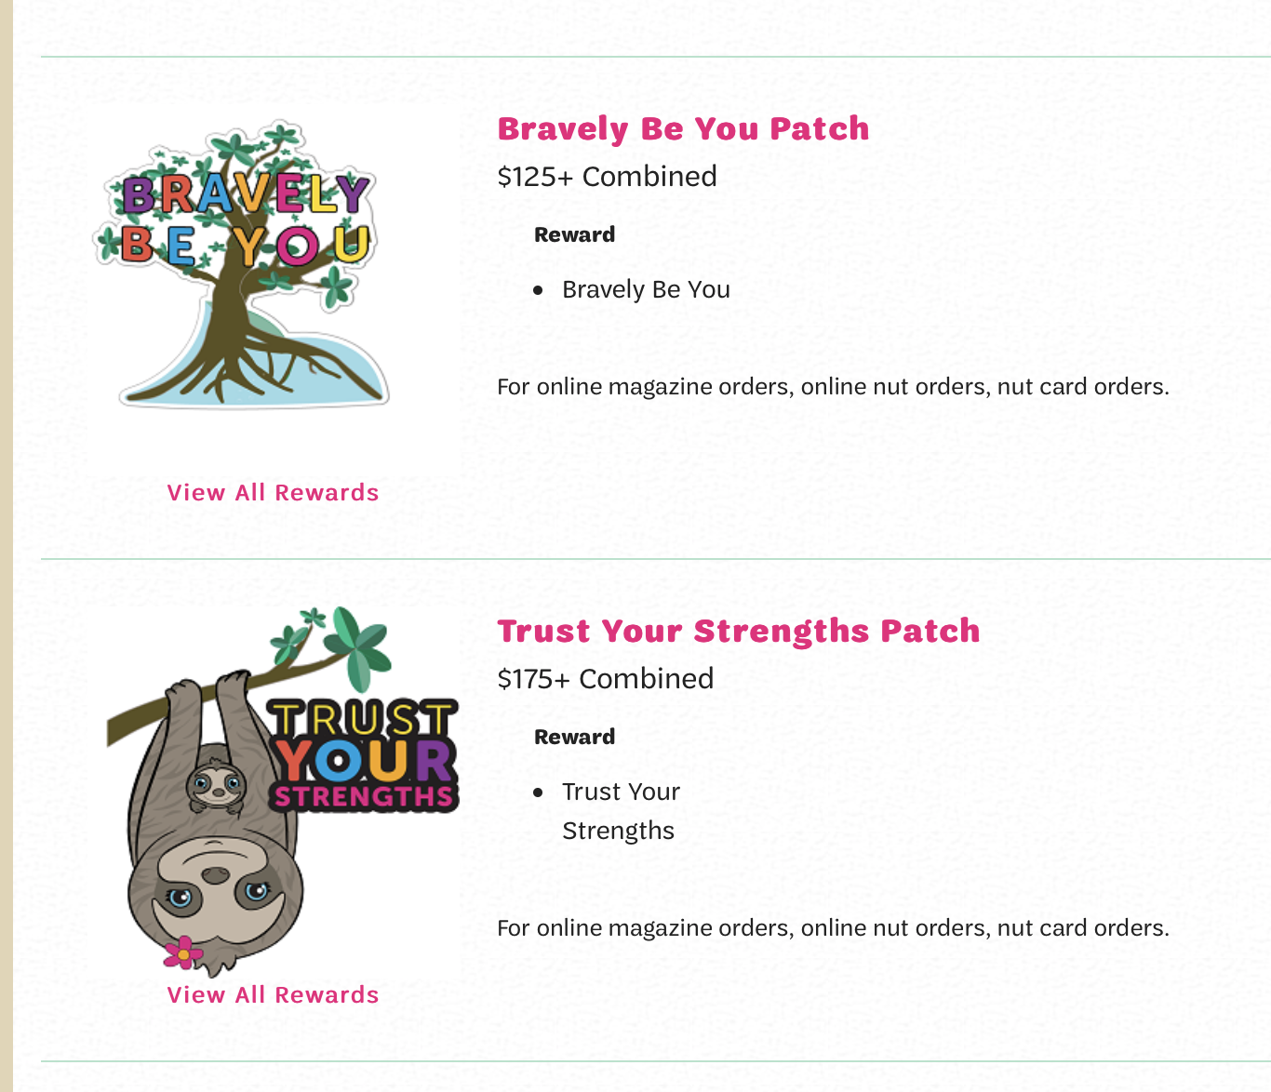
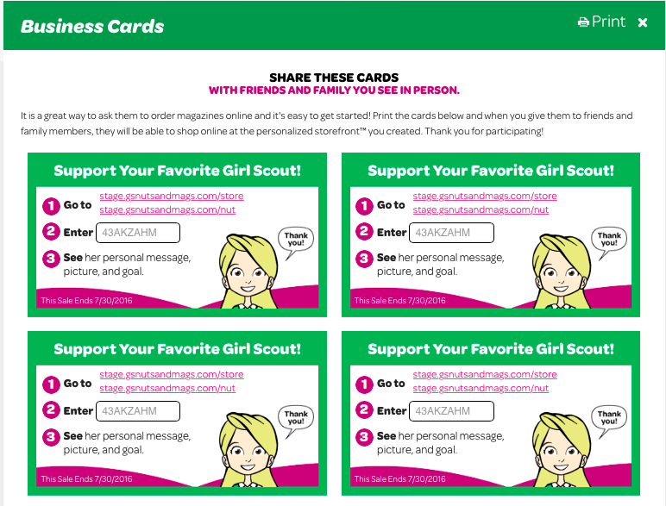
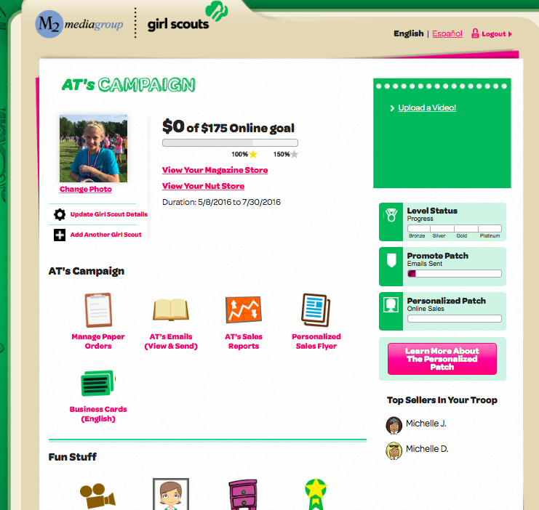
Girl’s Campaign HQ
Navigation tools for all aspects of the program
Emails/Social Media
Printable business cards with girl’s online store code
Manage paper orders (nut card sales entry)
Rewards earned and actions need to receive rewards
Reports

Slide 18
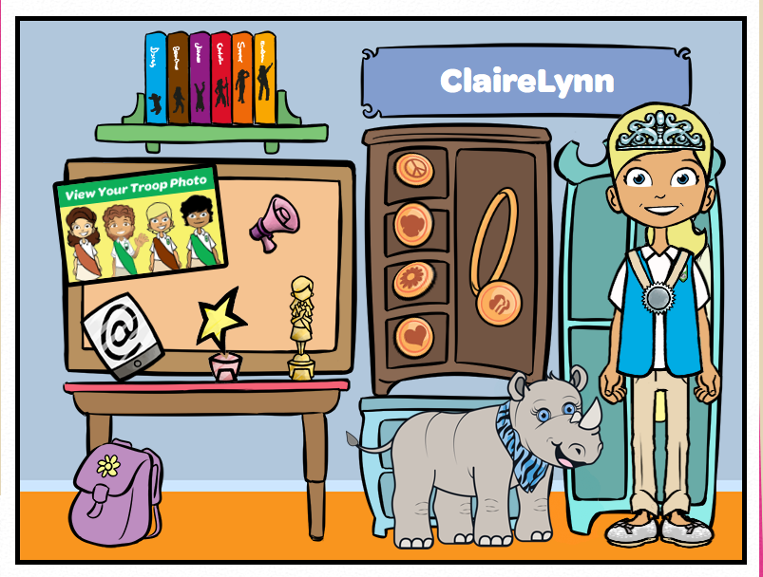
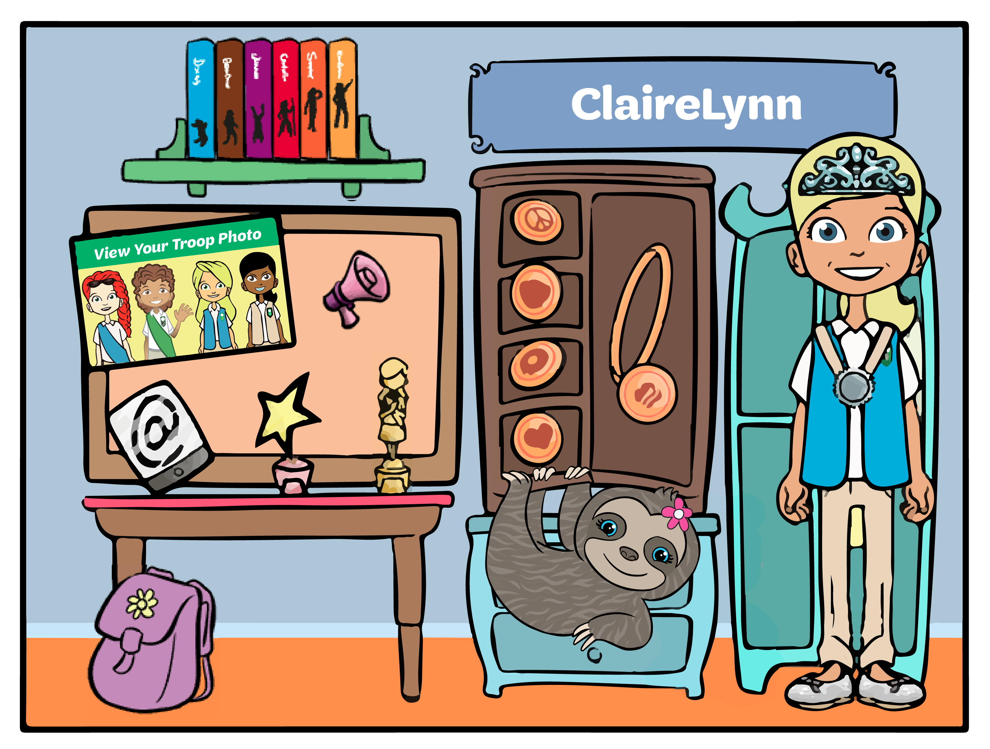
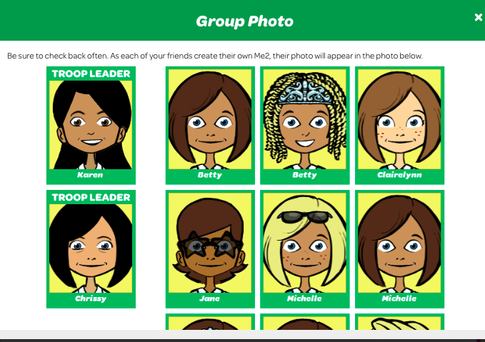
Avatar’s Room
Girls can earn virtual rewards for their avatars by completing actions within M2OS
Girls revisit their room an average of 4 times during the program
View virtual rewards earned and troop photo

Slide 19
2020-21 Fall & Girl Scout Cookie Crossover Patch
As a Girl Scout member, girls work to create change and to become dynamic leaders
To earn this crossover patch, girls must:
Participate in the 2020 Fall Product Program by creating an avatar and sending 15+ emails
Sell 250+ packages of cookies during the 2021 Cookie Program

Slide 20
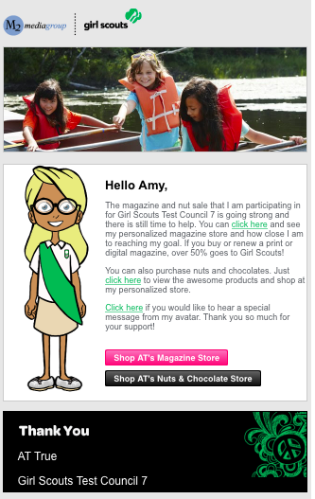
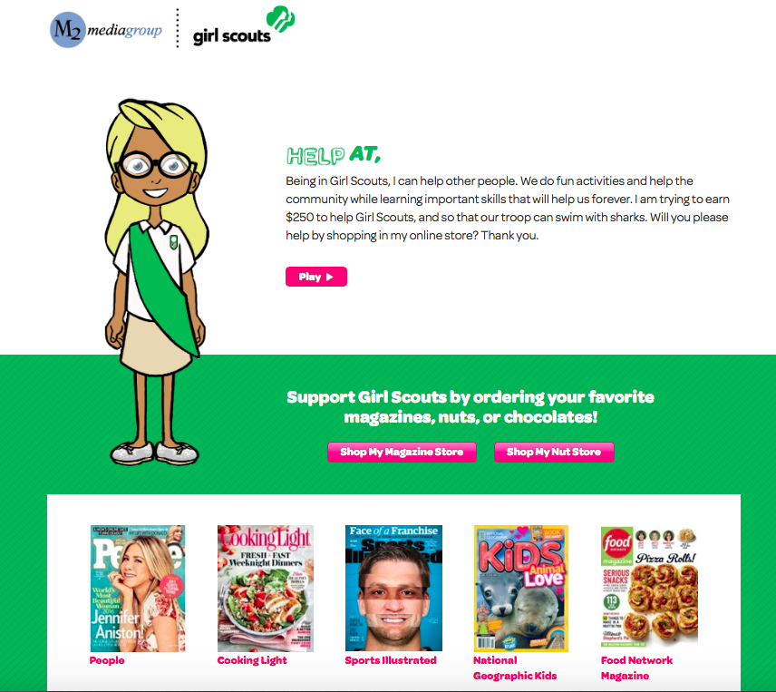
Customer Emails
Family and friends receive emails with links to shop for magazines and nuts/chocolates and can hear the special message recorded by their favorite Girl Scout

Slide 21
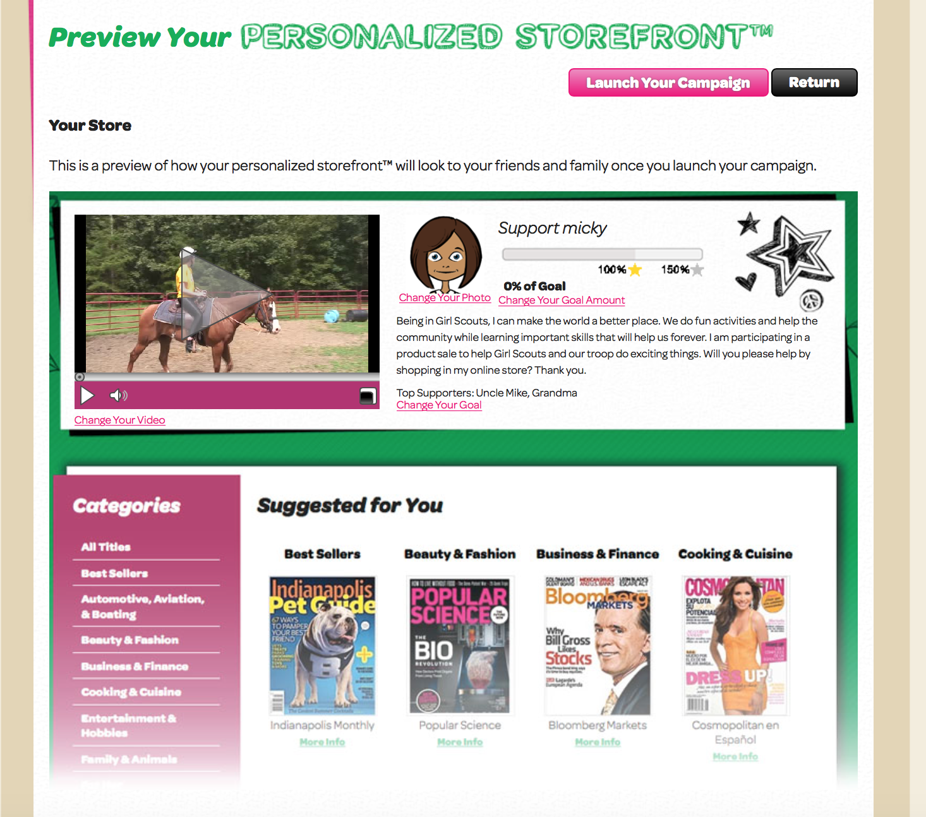
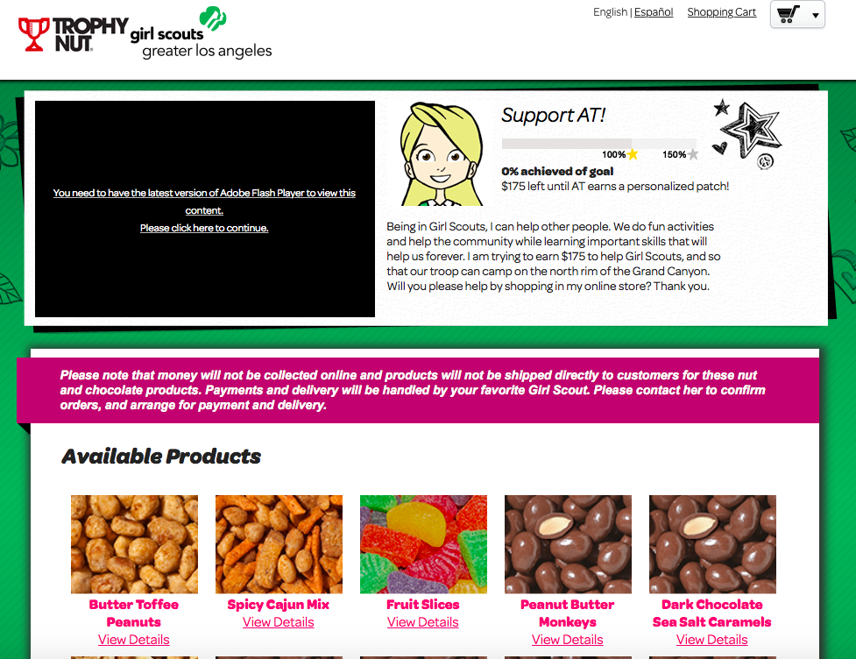
Online Storefronts
Magazine selections include all Time, Inc titles, Reader’s Digest and more!

Slide 22
Online Nuts/Chocolates
Customers have the option to choose girl delivered or direct ship
Customers pay for all products online at the time of checkout

Slide 23
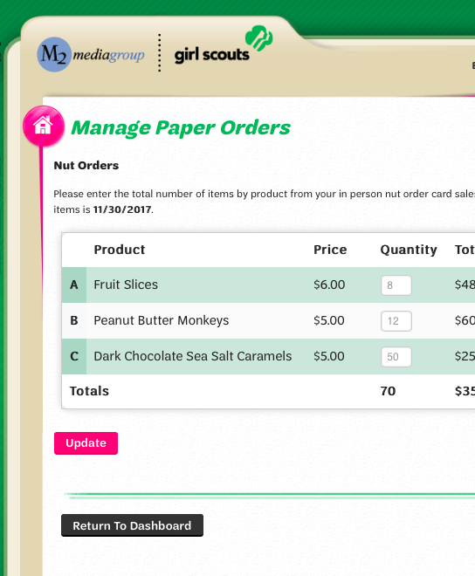
Entering In-Person Nut Order Card Items
Parents/girls enter the total of each item using the nut order card into the M2OS system prior to the end of the program
Nut order card totals will be tabulated and added to all online sales totals in reports
All in-person nut orders must be entered into M2OS system to be processed

Slide 24
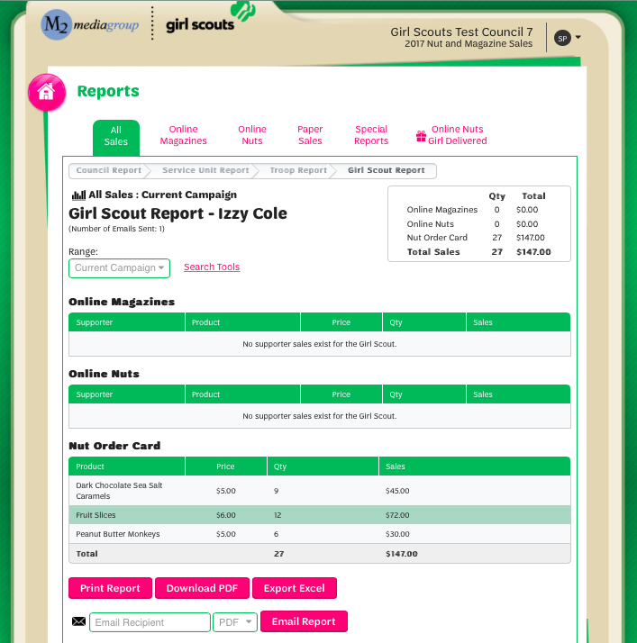
Reports
Reports broken out by sales categories
View all girl delivered items sold online by customer to see which products to deliver
Report emailed to parents at end of program

Slide 25
Staying Safe
Stay socially distant when possible.
When it's not possible to practice social distancing, be sure to always wear a mask – properly fitted over the nose and mouth.
Utilize contactless options when possible.
Stay tuned in to Black Diamond's webpage, as well as our Girl Scout Leadership Facebook group, for the most up to date information.
As always, follow your state's CDC guidelines.
HAVE FUN!

Slide 26
Important Dates
Program begins: October 1st
In-person girl order taking and girl delivered online order taking ends: October 30th
Last day for parents to enter paper orders in M2OS: October 30th
Online orders for Direct Ship Nuts and Magazines end: November 22nd
SU Nut Deliveries: November 13th
FINAL payment to council 12/18 (note: troops will ask for payment before this date).

Slide 27
Fall Product Program Customer Care
M2’s Customer Care team is cross-trained to handle tech support, volunteer/participant and customer inquiries
100% customer satisfaction guarantee

Slide 28
Fall Product Program GSBDC Customer Care
Do the volume of cases, we are unable to take cases through social media. If you want to reach a trained professional who can help you, the quickest way to reach us is through the customer care hotline – email and phone.
To be in M2 for the October start date Girls need to be registered by 9.14.2020.
GSBDC Customer Care
1-304-345-7722
customercare@bdgsc.org

Slide 29
Thank you!
You are the difference!
Thank you for contributing to the positive experiences girls have through the Fall Product Program
We appreciate you and all that you do to support Girl Scouts!

